Slide 1
Business Intelligence Project
1

Slide 2
Table of Contents
1
3
Methodology
2
Identification
Design
Development
4
Deployment
5
6
Key Takeaways
2

Slide 3
Methodology
3

Slide 4
Design
Deployment
Identification
Development
4

Slide 5
Identification
5

Slide 6
Identification
We need to answer the following
How are the sales’ performance and evolution?
How are we performing compared to the target?
Where do sales make low margins?
Using data about sales, targets, customers, products, sales representatives and sales managers.
6

Slide 7
Design
7

Slide 8
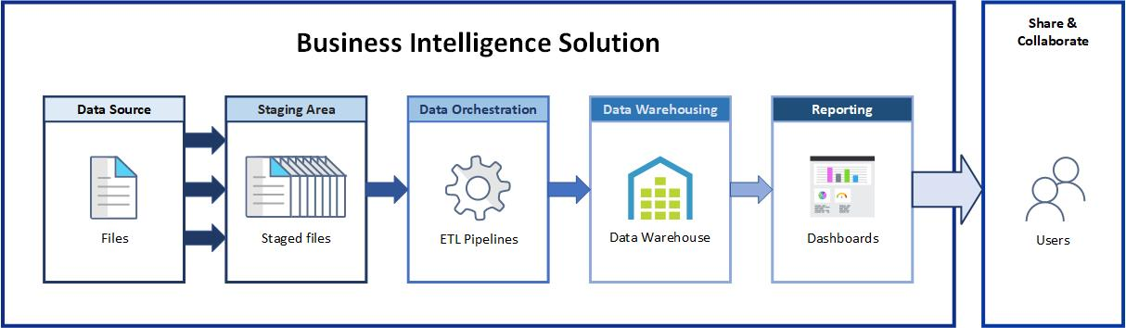
Functional Architecture
8

Slide 9
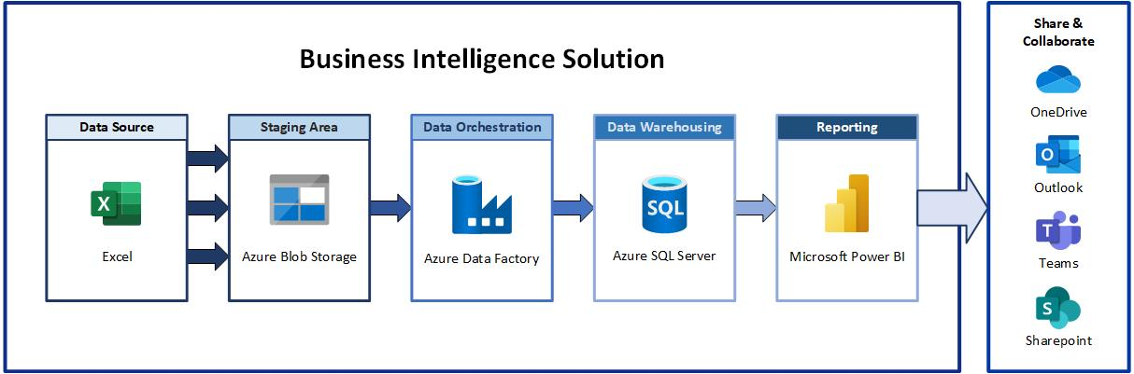
Technological Architecture
9

Slide 10
Development
10

Slide 11
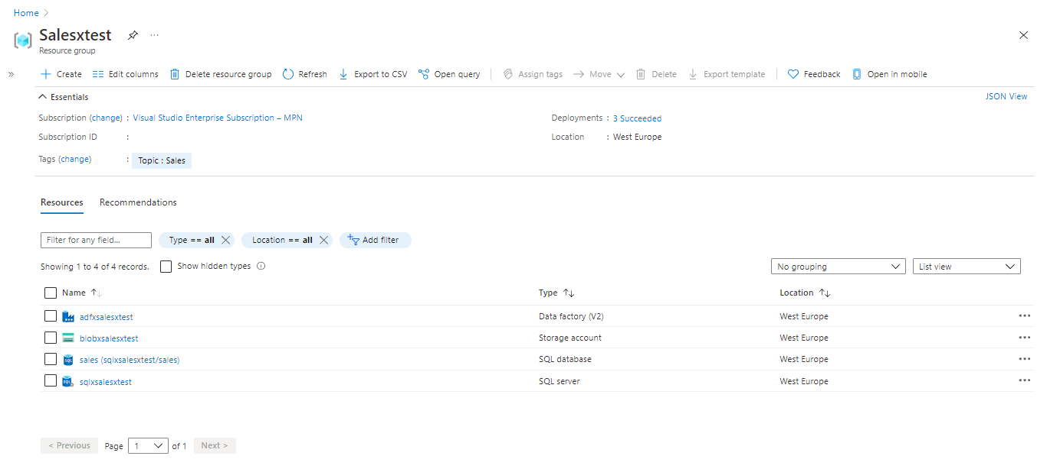
Cloud Resource Provisionning
11

Slide 12
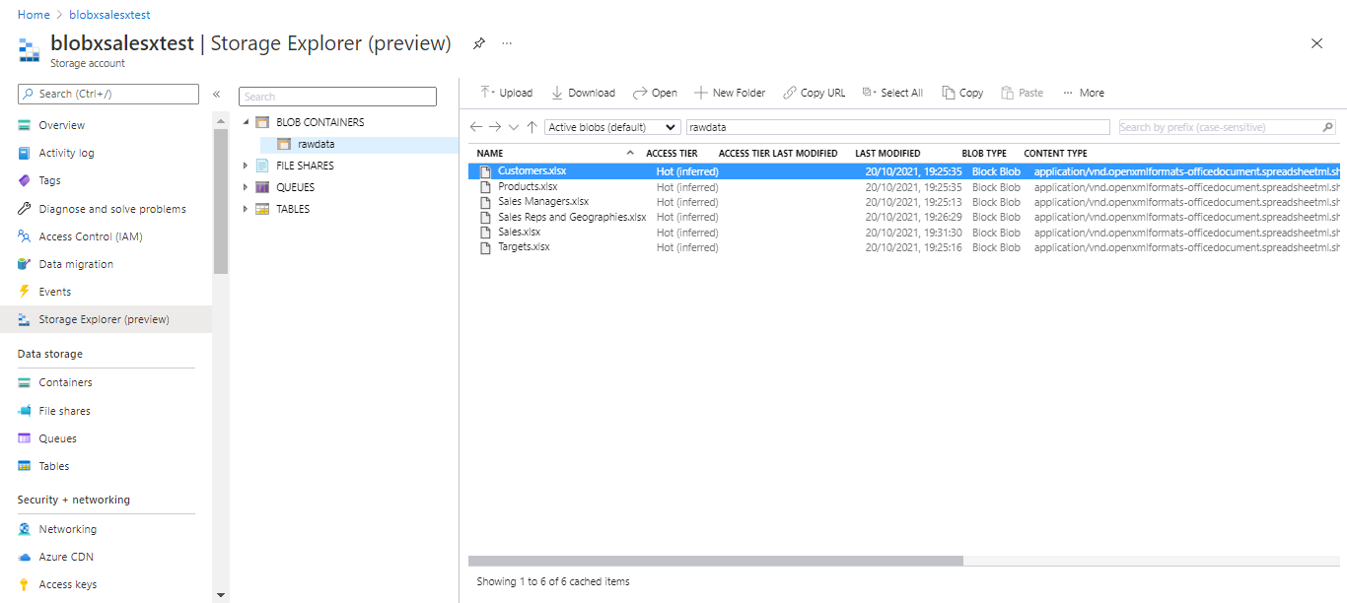
Staging
12

Slide 13
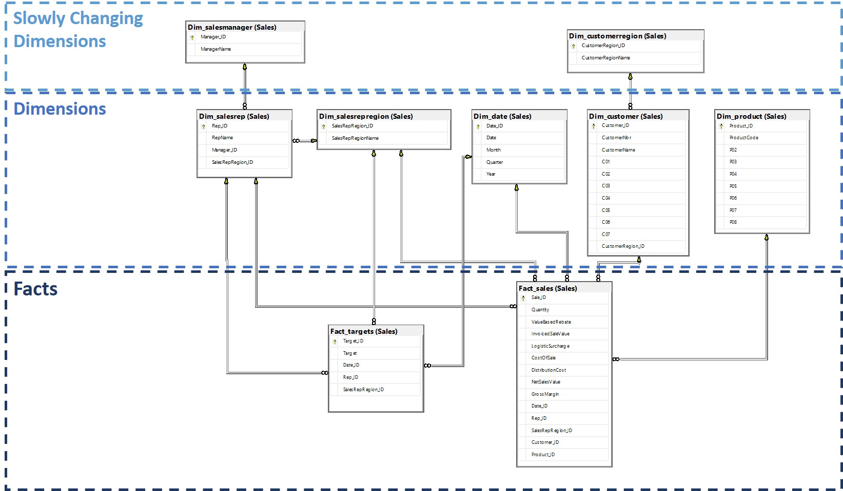
Data Warehousing
13

Slide 14
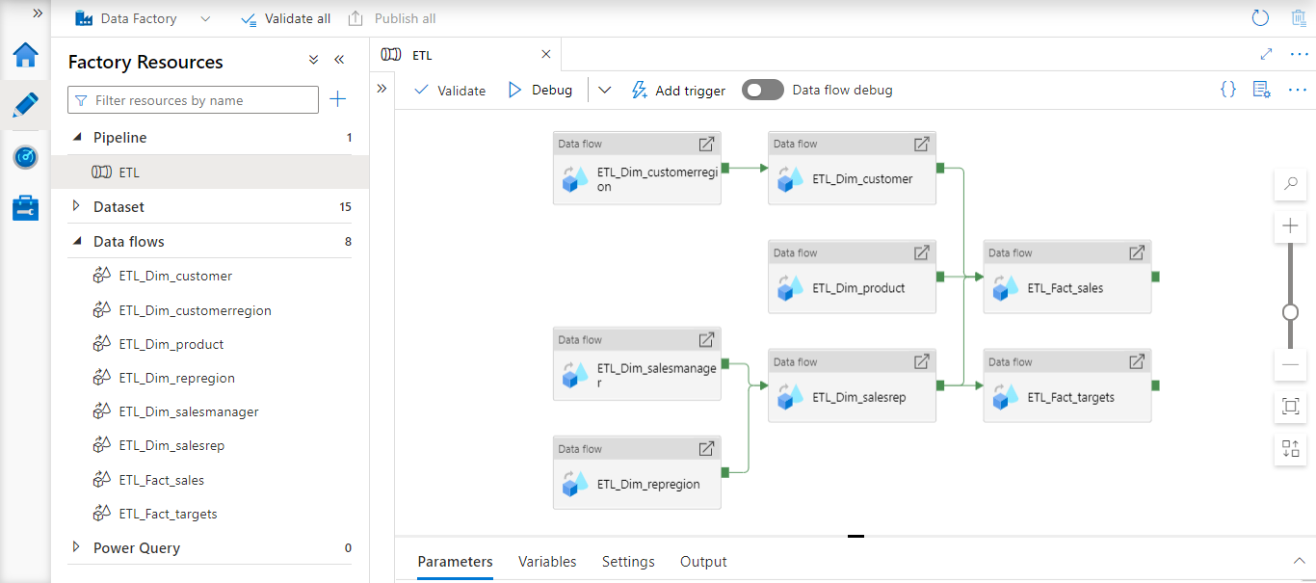
Data Orchestration
14

Slide 15
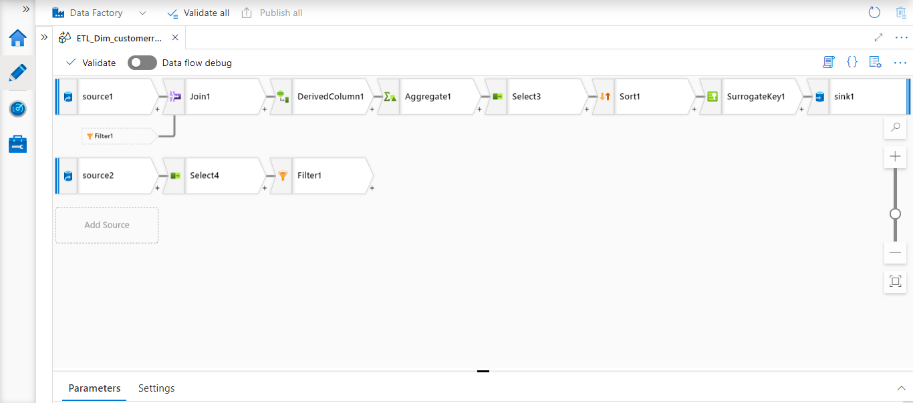
Data Orchestration
15

Slide 16
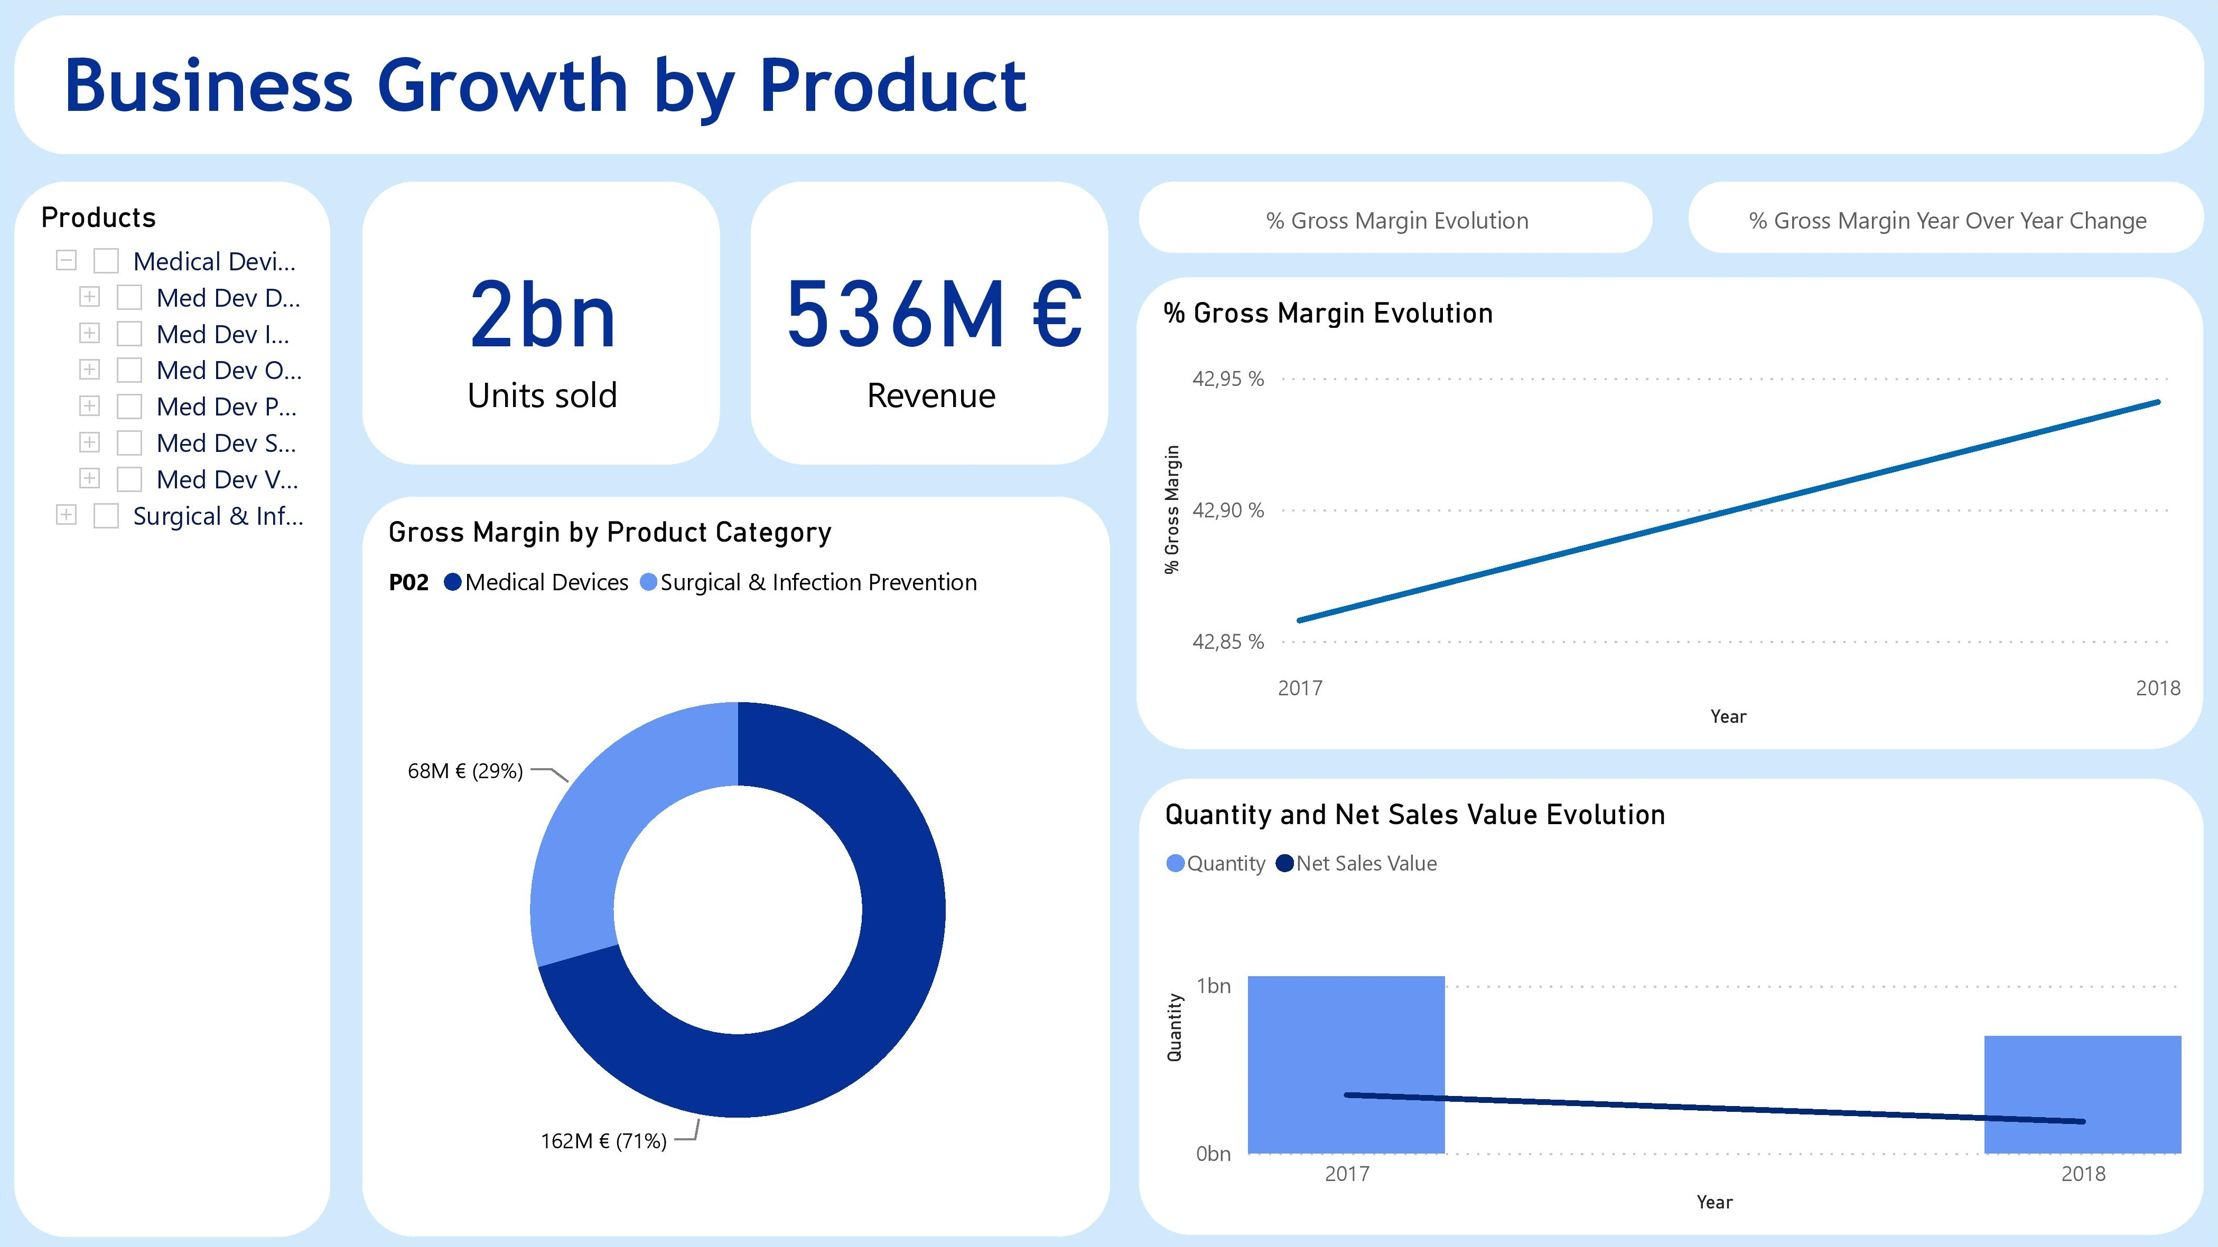
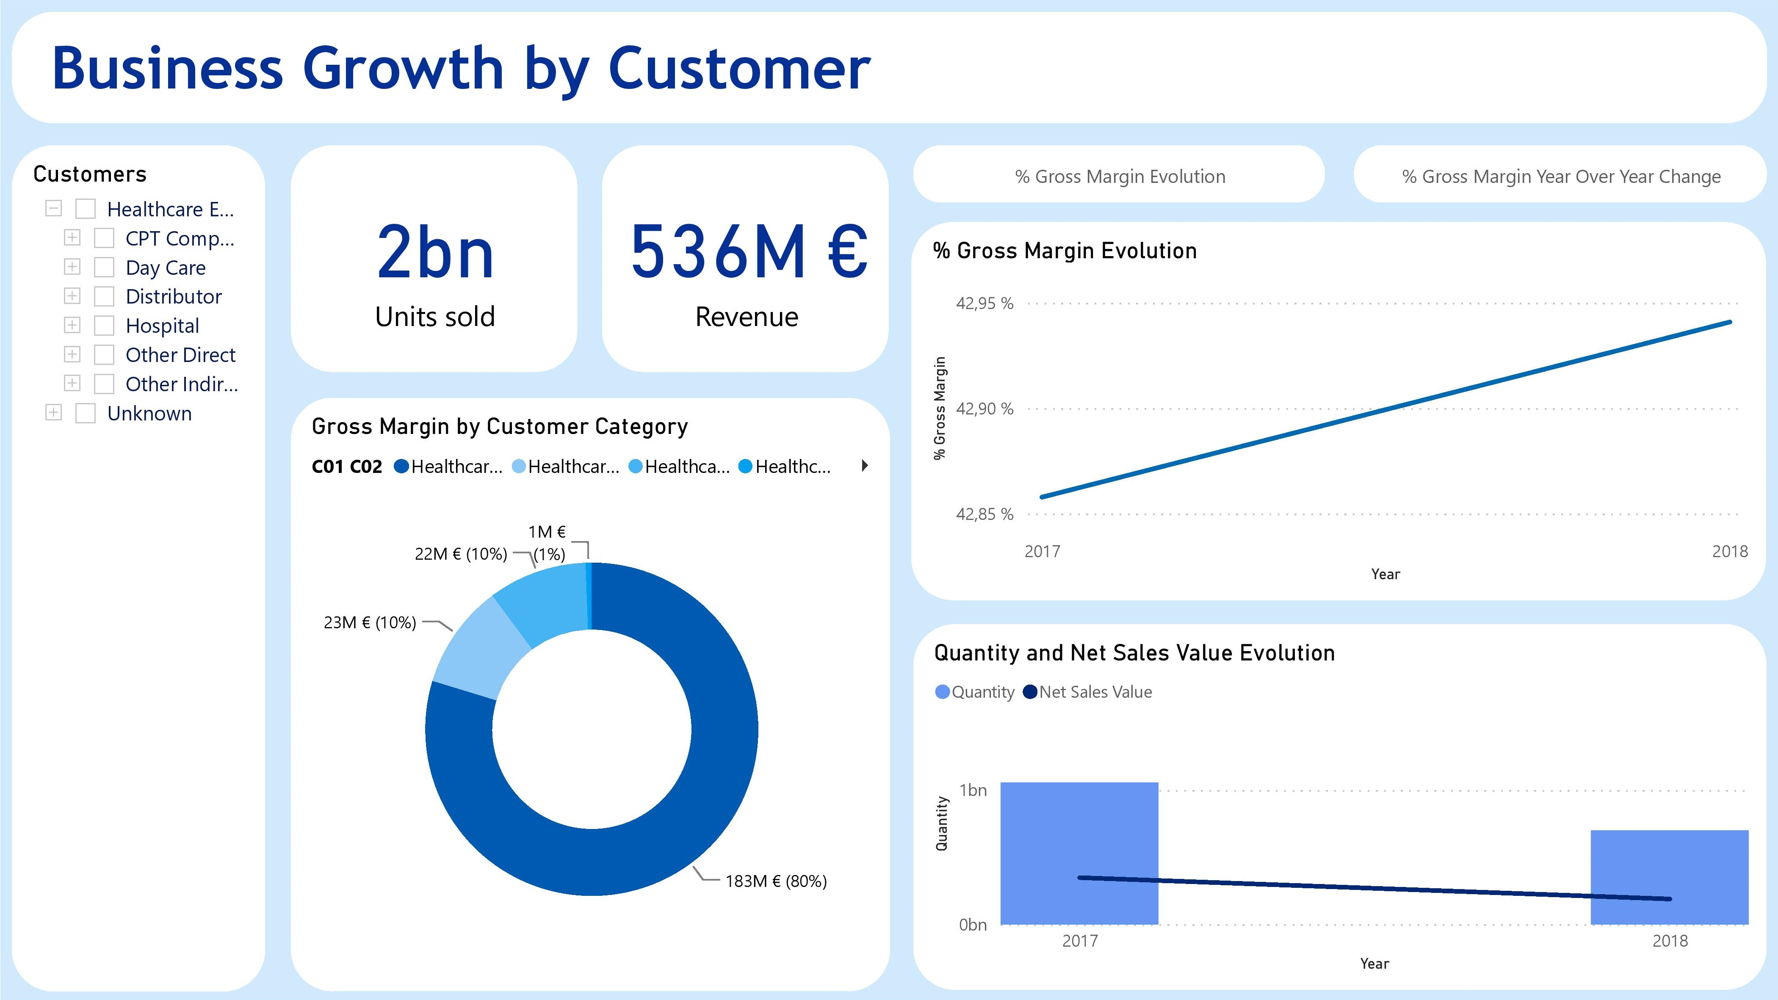
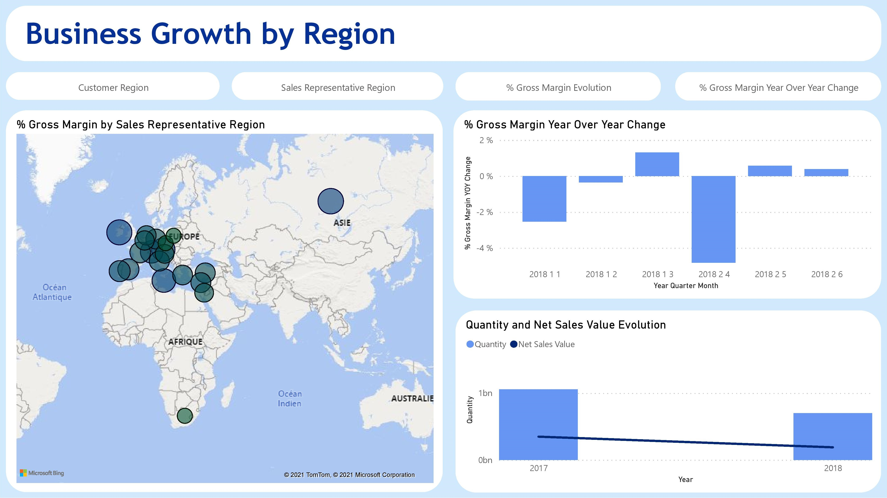
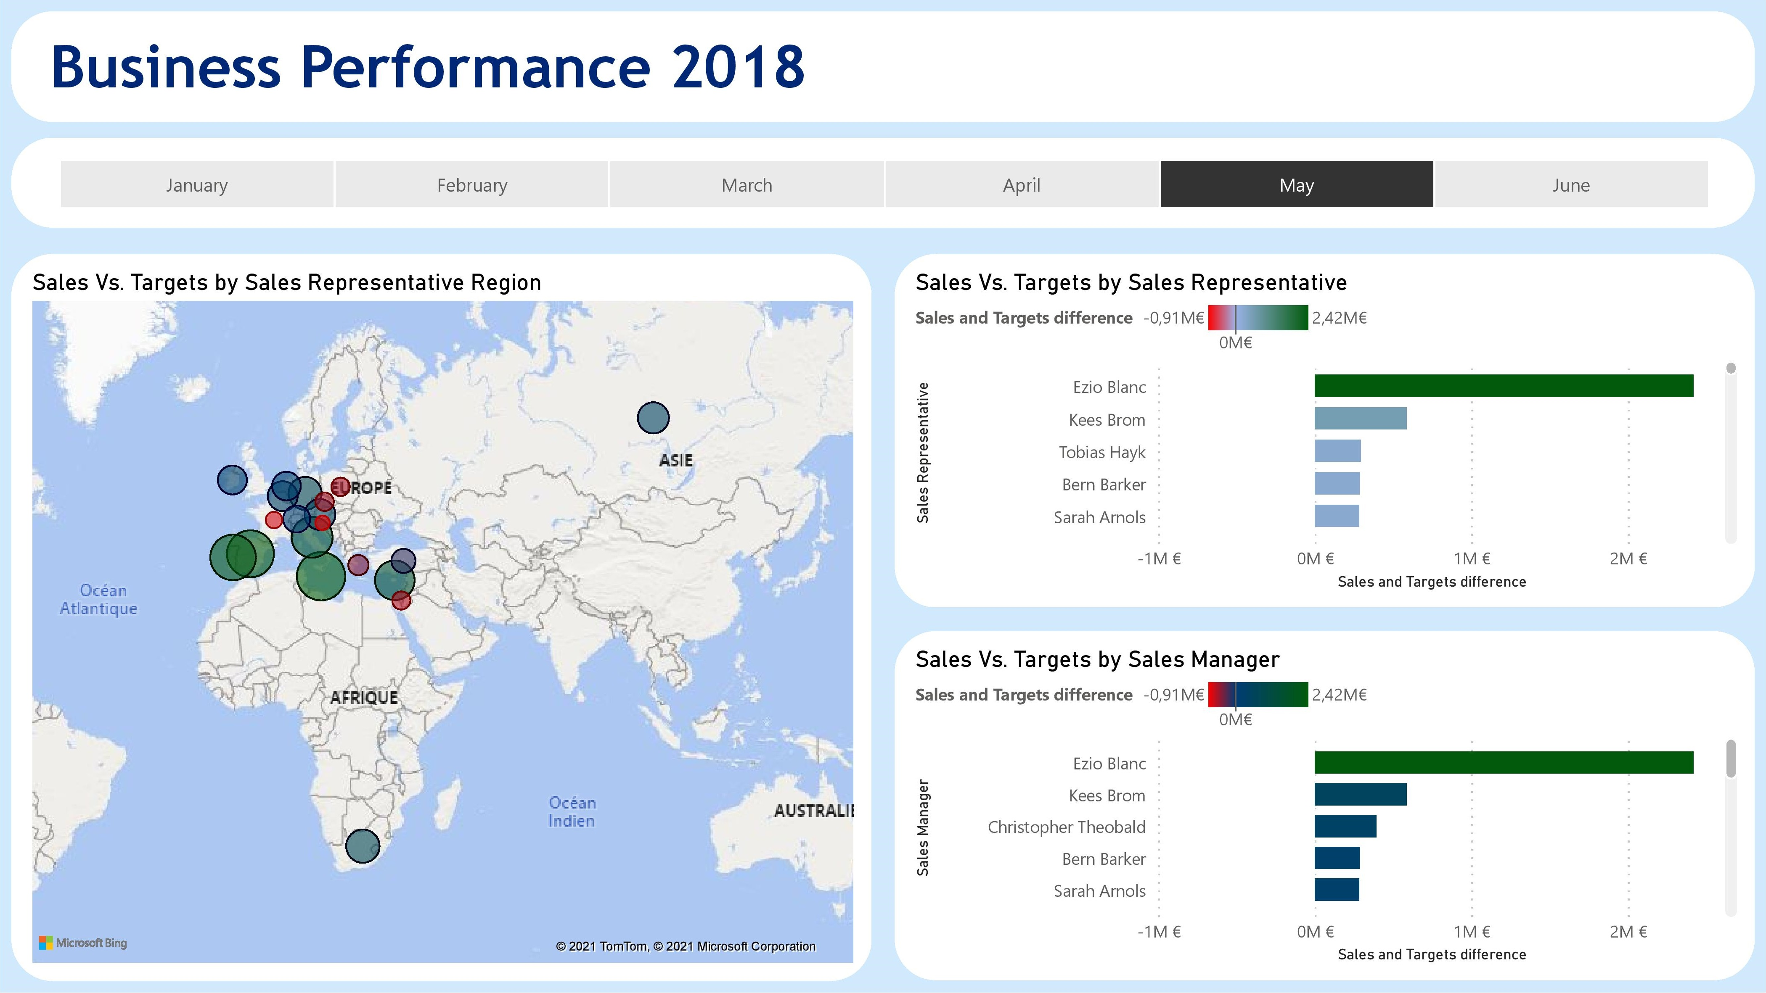
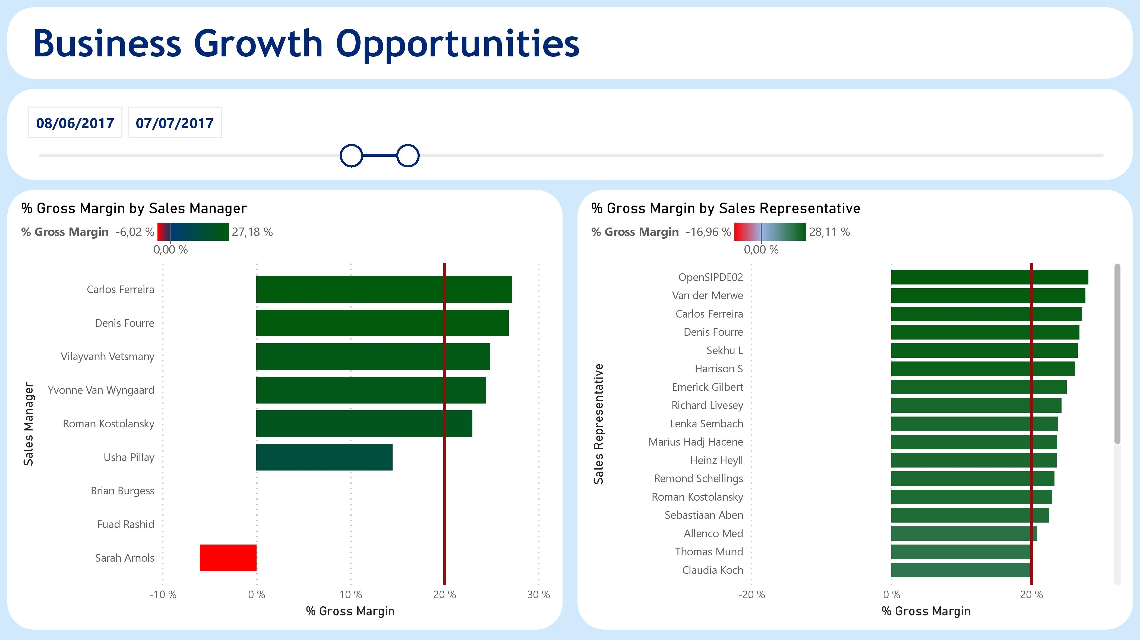
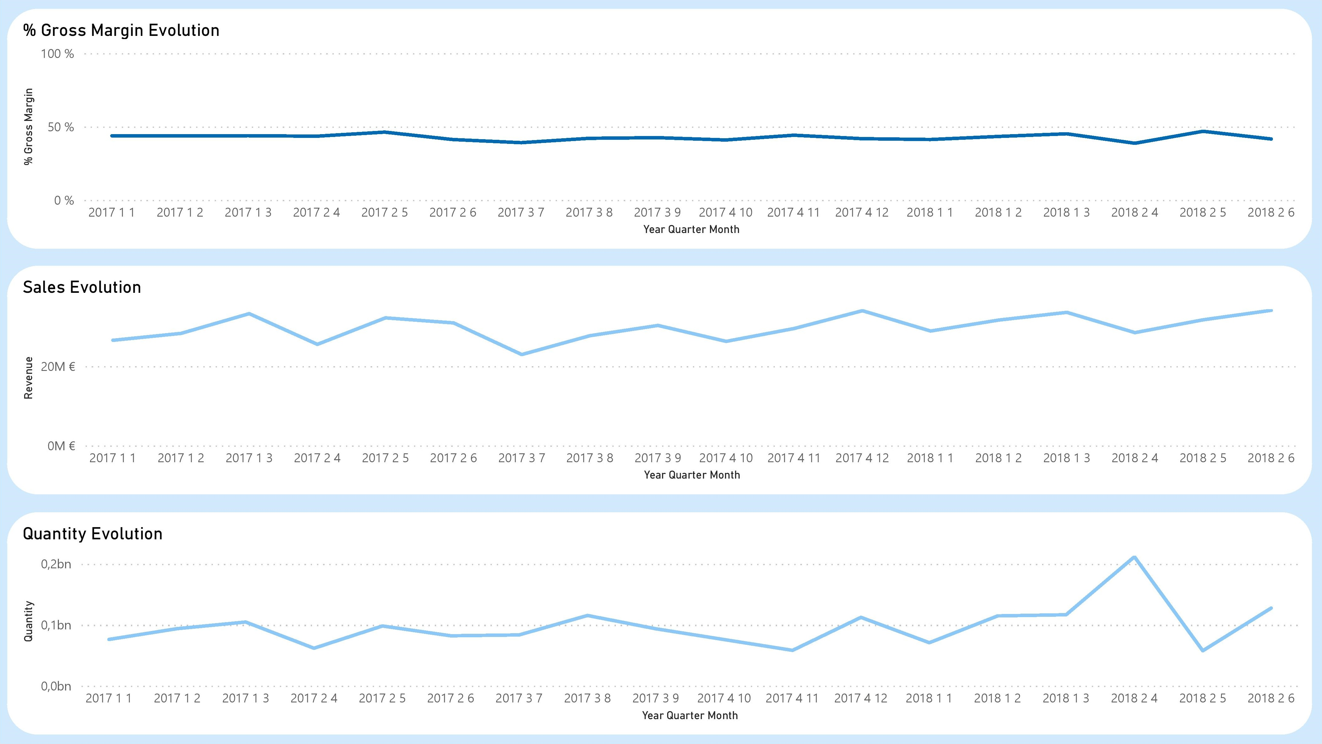
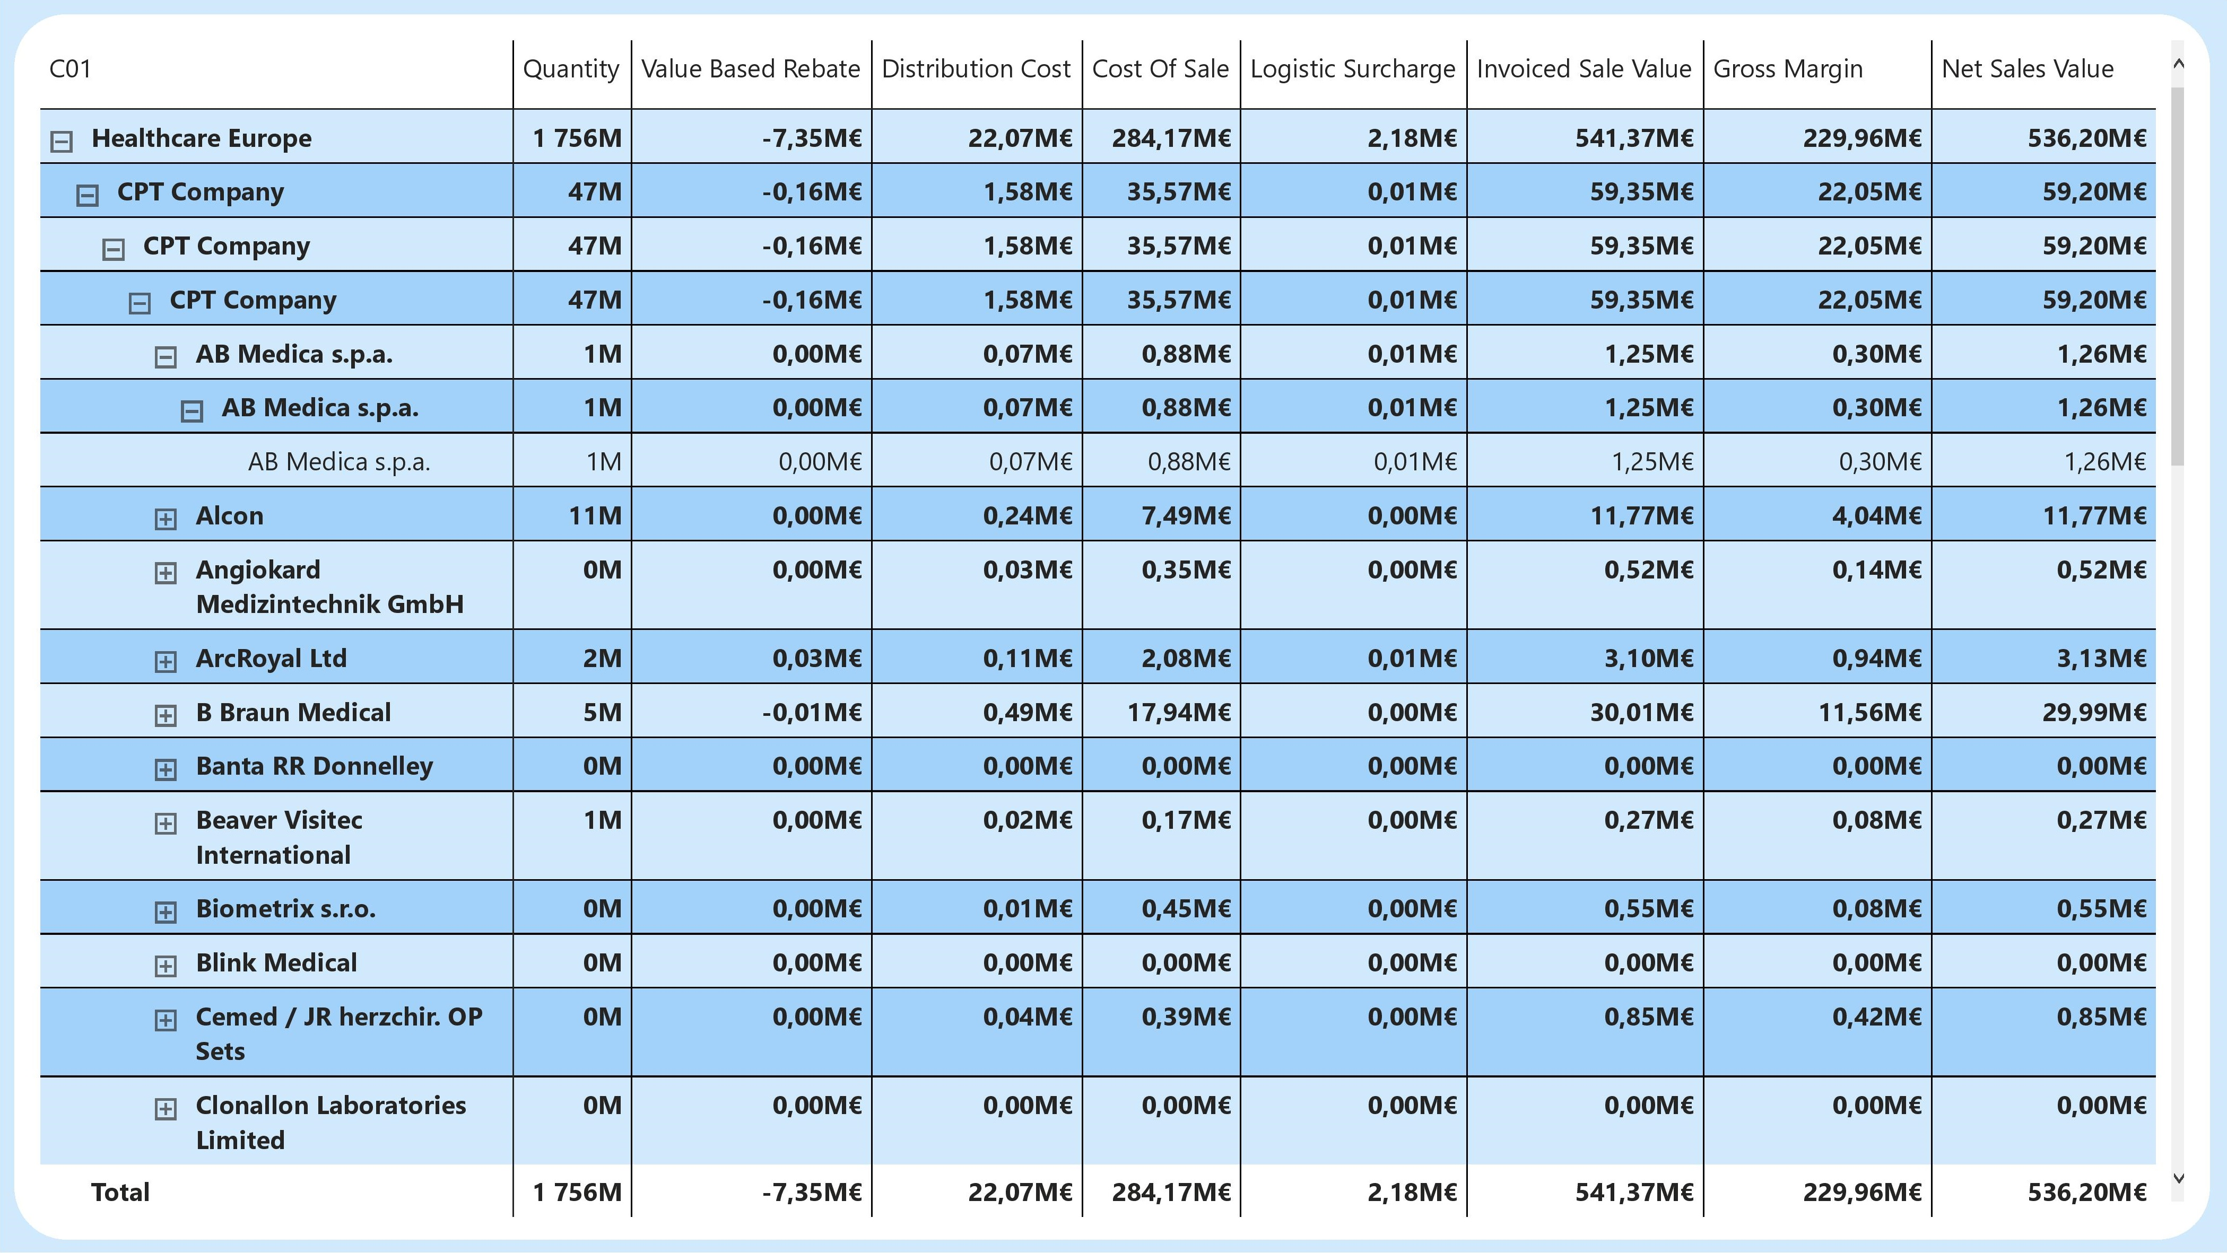
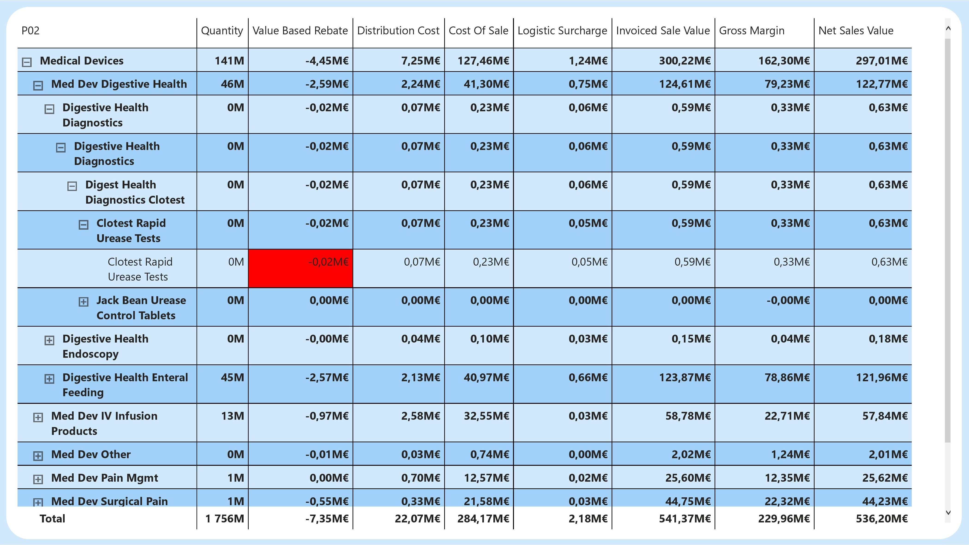
Reporting
16

Slide 17
Deployment
17

Slide 18
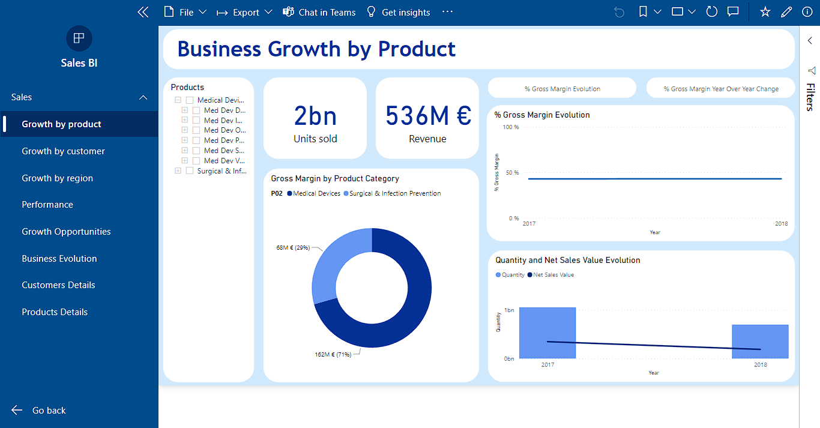
Application
18

Slide 19
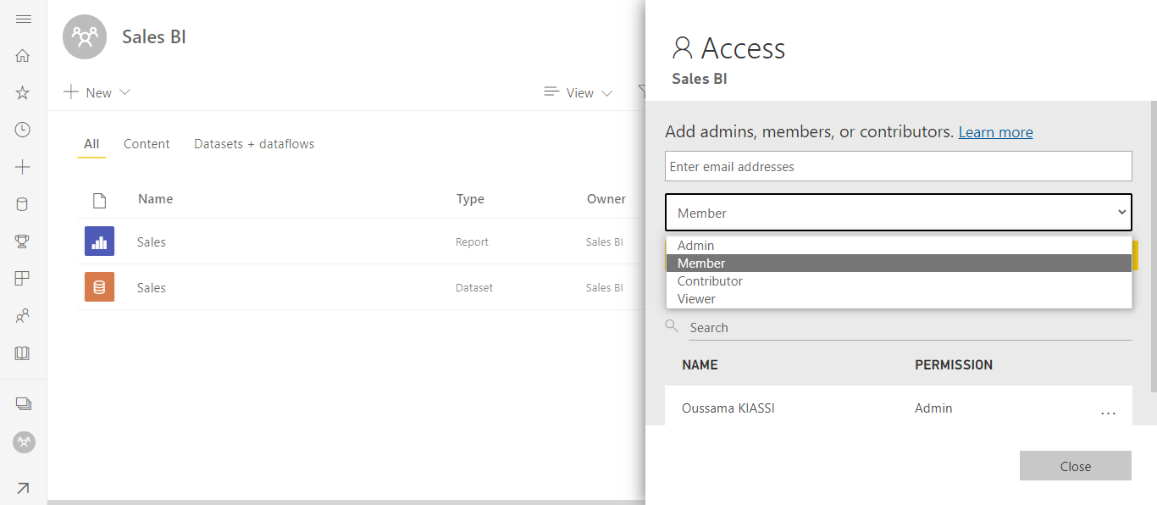
Access Management
19

Slide 20
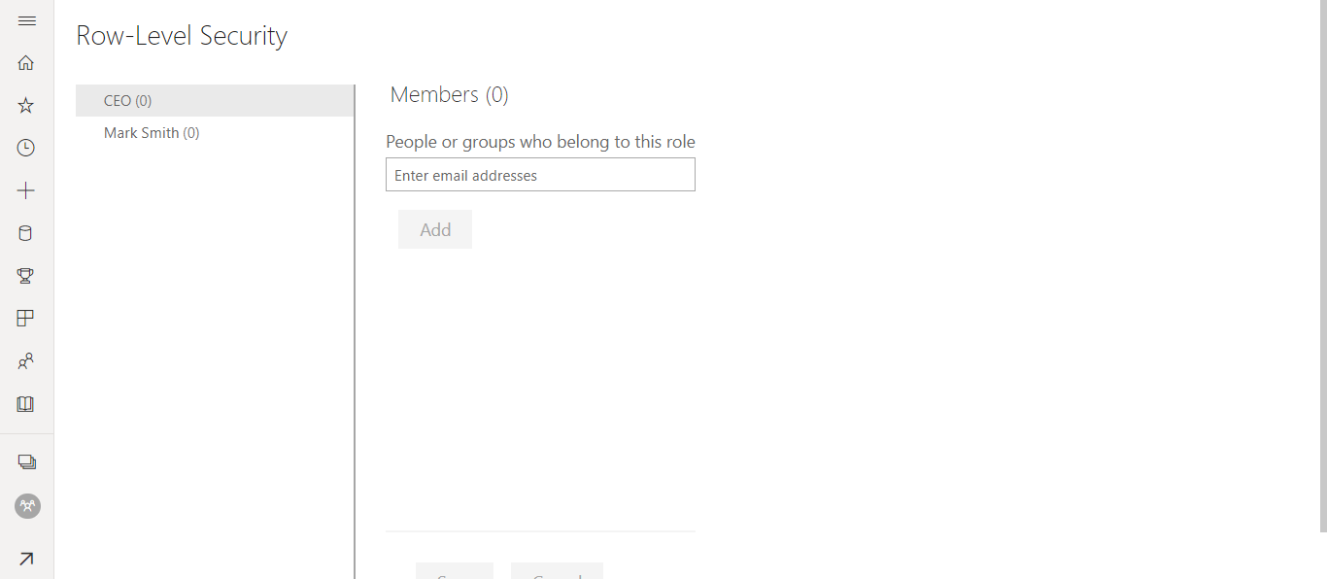
Row-Level Security
20

Slide 21
Key takeaways
21

Slide 22
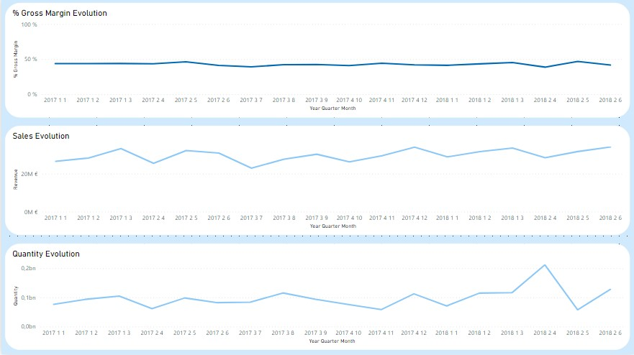
How are the sales’ performance and evolution?
22

Slide 23
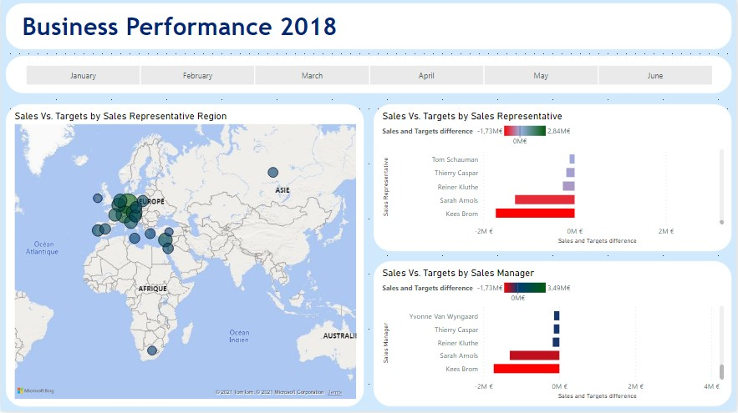
How are we performing compared to the target?
23

Slide 24
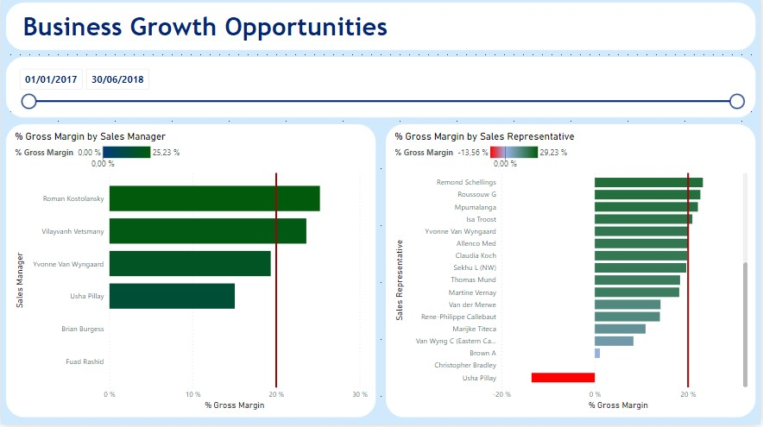
Where do sales make low margins?
24

Slide 25
Demo
25

